Slide 1
Arrowhead hackathlon
Csaba Hegedűs
Zoltán Umlauf
hegeduscs@aitia.ai
zumlauf@aitia.ai

Slide 2
We need to talk.
Arrowhead 4.0 release overview and pointers
Glance into the core systems
Information model, identifiers and descriptor objects
Database structure
Module configs
Glance into how consumers and providers should work
Pseudocode
REST interfaces
Using the Java and C++ skeletons – implementing

Slide 3
4.0 release overview
Client skeletons in Java:
Generic Service Provider
Generic Service Consumer
EventHandler Publisher
EventHandler Subscriber
Client skeletons in C++:
Generic Service Provider
Generic Service Consumer
Raspberry Pi 3 image w/ core
SensorGW for non-REST devices
Docker images for the core
Released Core Systems:
ServiceRegistry DNS
ServiceRegistry SQL (dev)
Orchestrator (and Store)
Authorization System
Gatekeeper
Gateway
EventHandler
Two implementations:
Each core system as separate executable
All core systems as one jar (lightweight)

Slide 4
Pointers
Development github repositories (most up-to-date):
https://github.com/arrowhead-f
Release repo & Arrowhead framework wiki (WIP) && release binaries:
https://forge.soa4d.org/anonscm/git/arrowhead-f/arrowhead-f.git
https://forge.soa4d.org/plugins/mediawiki/wiki/arrowhead-f/index.php/Main_Page
Within the wiki, use the „Files” and „Docs” tabs on the menu bar!
Quickstart package:
https://forge.soa4d.org/frs/?group_id=58
Owncloud/WP1/T1.4_Implementation
https://drive.google.com/file/d/1APgBgs24G_6tPJtdQuRMHCONX6tBXn89/view?usp=drive_web

Slide 5
Implementation
Details:
Java 8 EE (Jersey API), Hibernate ORM, log4j
MySQL (or Postgre or other SQL), BIND9
Maven project(s), (IntelliJ)
Two implementations:
Separate modules
Every core system as separate Java executable, own HTTP(S) server
Properties files for each core system
Lightweight, merged, single jar
One Java executable, one HTTP(S) server
One global property file

Slide 6
Raspberry Pi 3B image
The image is for a 4GB microSD card (hopefully class 10 or above).
Preconfigured:
Arrowhead core framework pre-configured
Git, Maven, JDK 1.8, MySQL (MariaDB)
PhpMyAdmin: http://ip/phpmyadmin
Devtools (MCEdit, iptables…)
Mosquitto MQTT broker
The Raspberry hosts a Wi-Fi network and tunnels Internet if connected to eth0
Wi-Fi access point details:
WiFi SSID: Arrowhead-Raspi-IoT#, password: arrowhead
Raspi is DHCP master on the 192.168.42.10-50 range
Raspi is the 192.168.42.1
https://learn.adafruit.com/setting-up-a-raspberry-pi-as-a-wifi-access-point/install-software

Slide 7
Raspberry Pi 3B image II.
The arrowhead framework automatically starts on the Raspberry after boot, using insecure mode:
Every core system listens on port 8440 at insecure mode
Execute the „start_secure_arrowhead.sh” to invoke secure mode
Alternatively you can manually start the JAR file in the target folder with the „-tls” command line argument
Core Systems will listen on port 8441, except the Gatekeeper, which will listen on 8447 (Gatekeeper needs different SSLContext)
To update your 4.0 lightweight implementation, go to the arrowhead-lw folder and then:
Pull the changes: git pull
Create the new JAR with maven: mvn package

Slide 8
Raspberry Pi 3B image III.
If the start/stop scripts were also updated for some reason during the pull, you need to give global read/write access to them again, in order to make the automatic framework start working again
Use „chmod 777 <file_name>” to do so
If you want you can configure the arrowhead (systemctl) service, change /etc/systemd/system/arrowhead.service
If a new version of the Raspberry specific implementation comes out, and you want to update:
git clone https://github.com/arrowhead-f/core-java.git -b <name of the new branch>
Duplicate the property files inside the config folder, and remove the .sample part from the end
Or alternatively wait for a new Raspberry image to be released

Slide 9
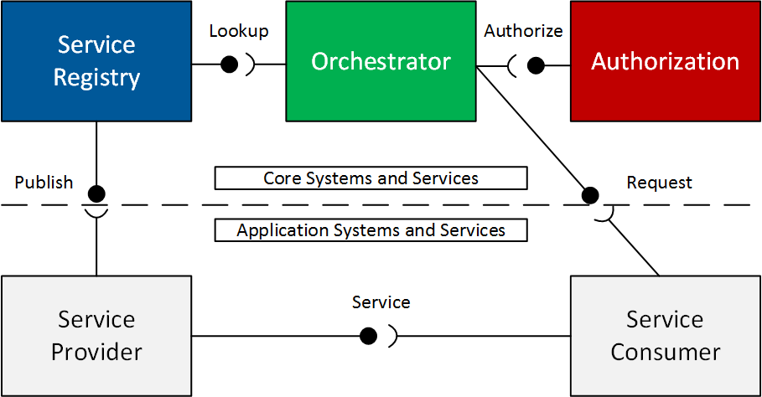
Arrowhead Core Framework
Minimum working set
Advanced working set

Slide 10
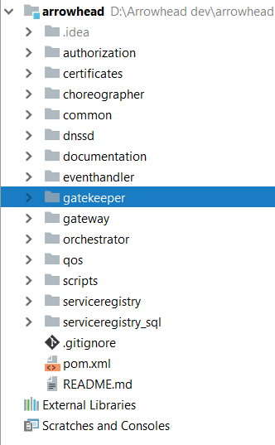
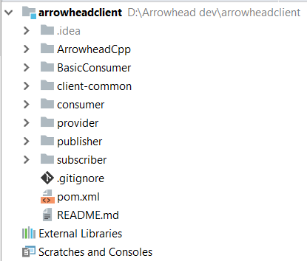

Slide 11
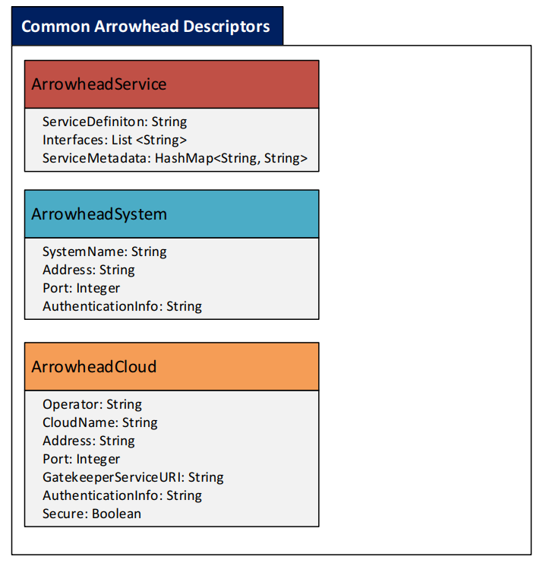
Arrowhead objects

Slide 12
The Arrowhead core database structure I.
Each core system can have its own separate database, or core systems can use 1 joint core database
The common descriptors can be seen on the right side
Authorization tables
Gatekeeper tables

Slide 13
The Arrowhead core database structure II.
Service Registry
Orchestrator
Event Handler

Slide 14
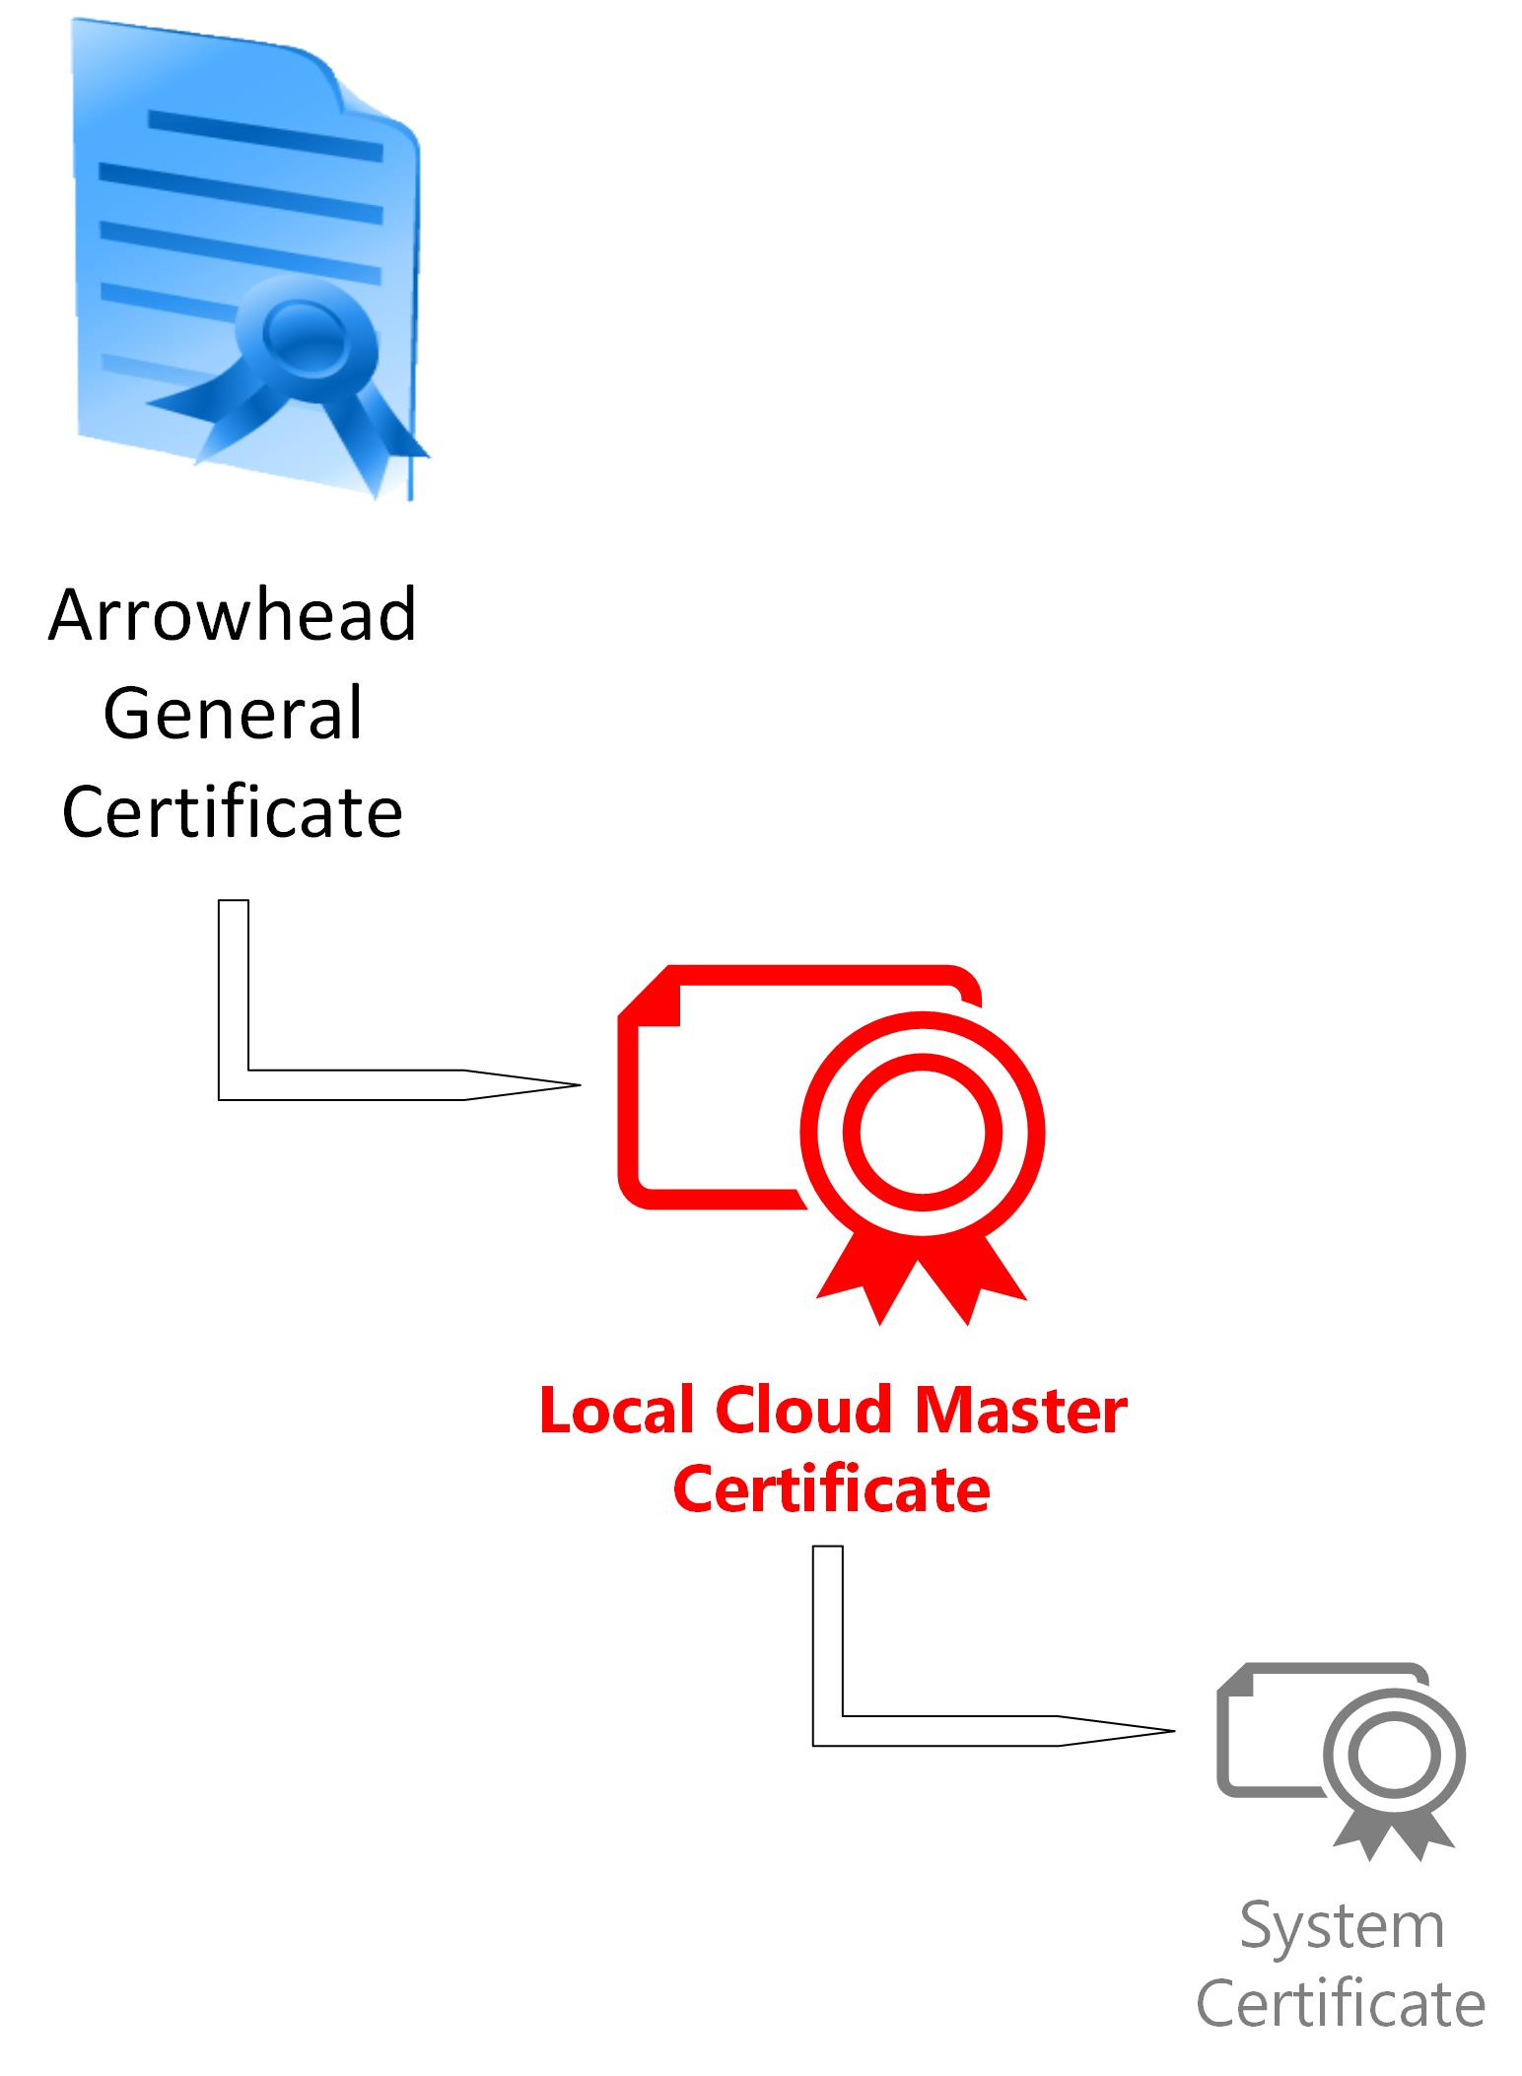
Security features
No security, plain HTTP (insecure developer mode)
Arrowhead PKI with tokens
May be self-signed or issued by e.g. Verisign
Managed by the AH consortium
Issued by the consortium when a new Local Cloud is deployed
AH Master CA
Cloud 1 CA
Cloud 2 CA
System A Certificate
System B Certificate
…
System M Certificate
System N Certificate
System O Certificate
…
System X Certificate
Issued by the local Authorization System upon BOOTSTRAPPING

Slide 15
The token itself
Two fields (SHA1withRSA; Base64)
Encrypted JSON (<=244 bytes)
Signature of the local Authorization System
Token Generation Service
Orchestrator or Consumer
Authorization

Slide 16
RawTokenInfo
cipher = Cipher.getInstance("RSA/ECB/PKCS1Padding");
The encoded JSON:
{
„c”:”<SystemName>.<SystemGroup>.<CloudName>.<Operator>”,
„s”:”<interface>.<ServiceName>.<ServiceGroup>”,
„e”:”<endTimeInEpoch>”,
}
public class RawTokenInfo
{
private String s;
private String c;
private Long e;
}

Slide 17
Core Systems

Slide 18
ServiceRegistry
A register that stores who provides what services at the moment.
It is up-to-date, dynamic information
Primary: DNS-SD as database (BIND9)
Developer or special needs: SQL as DB
Cleanup functionality:
Periodic ping of ServiceProviders (remove if no response)
Ping upon lookup
Advanced lookup
Using metadata and other search criteria

Slide 19
The Orchestrator
Used terminology: intra- and inter-Cloud orchestration
Consists of two modules:
Orchestration Store Service: mandatory, but not mandatory
Orchestration Service logic: optional, but advised
Request-response based („orchestration pull”)
Input: Service Request Form
Output: Orchestration Response (List<OrchestrationForm>)
Capable of 3 orchestration scenarios:
Default configuration (for booting of App. Systems)
Store-based orchestration (with a backup list of Providers for a given Service for a given Consumer)
Dynamical orchestration
In the latter two, inter-Cloud orchestration is included if necessary

Slide 20
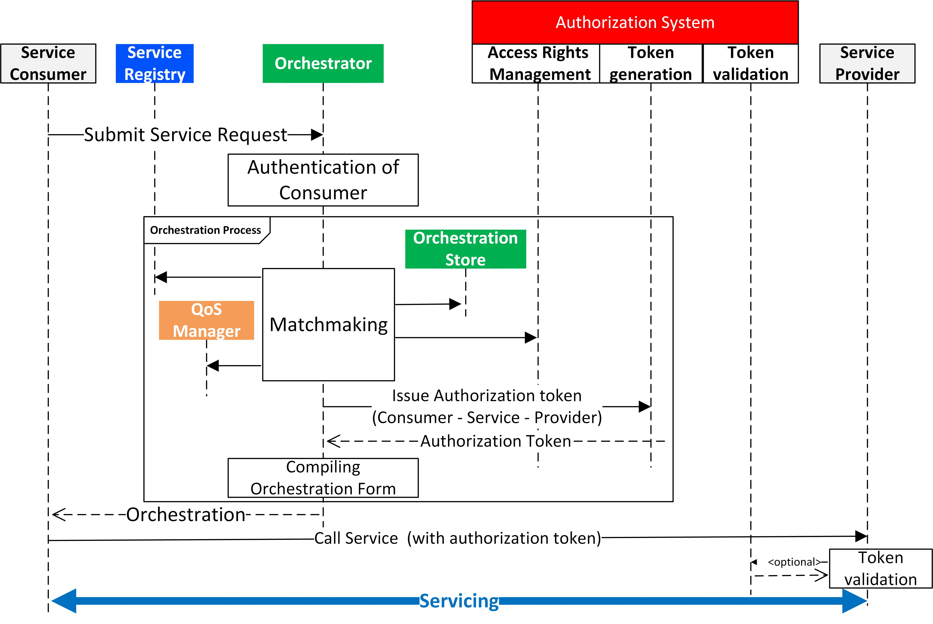
Orchestration Service

Slide 21
Authorization System
The Authorization System stores access control rules.
<<provider>> <<service>><<consumer>>
<<service>><<cloud>>
It also stores public keys for every core system (token!).
Two services:
AuthorizationControl
TokenGeneration Service

Slide 22
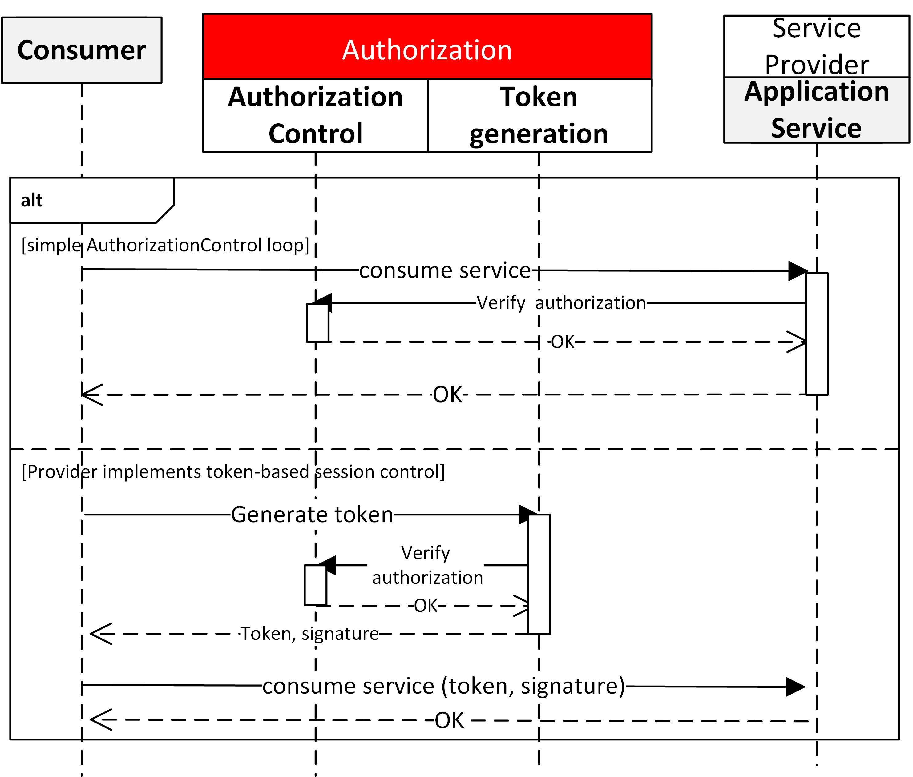
When not using the Orchestration Service

Slide 23
EventHandler
Publish-subscribe mechanism over HTTP(S).
No event processing, just distribution with special subscription criteria/filter.
Two services:
EventSubscribe
EventPublish

Slide 24
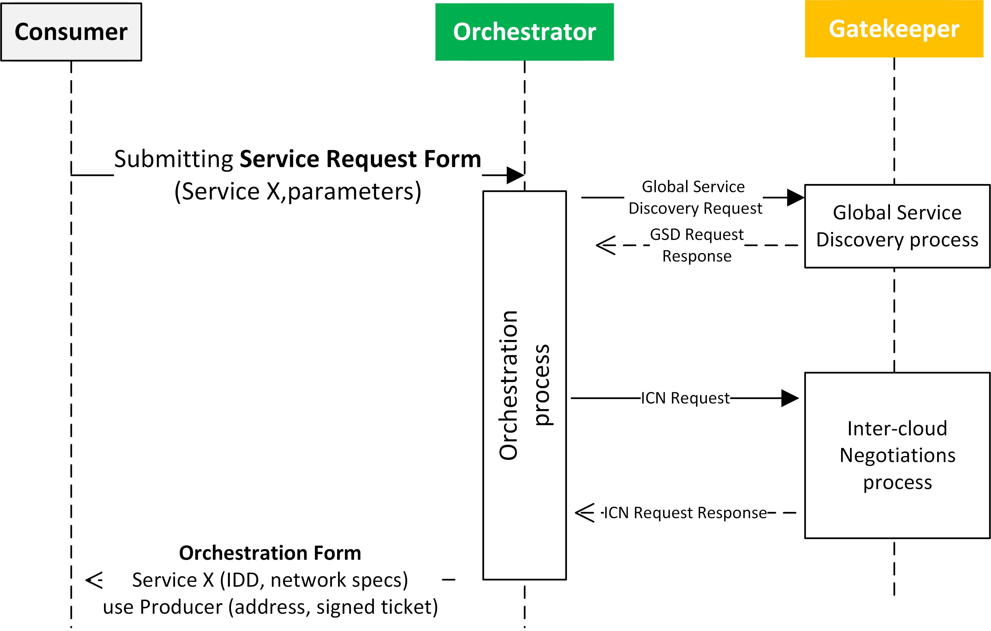
Gatekeeper & Gateway
That is a whole story on its own.

Slide 25
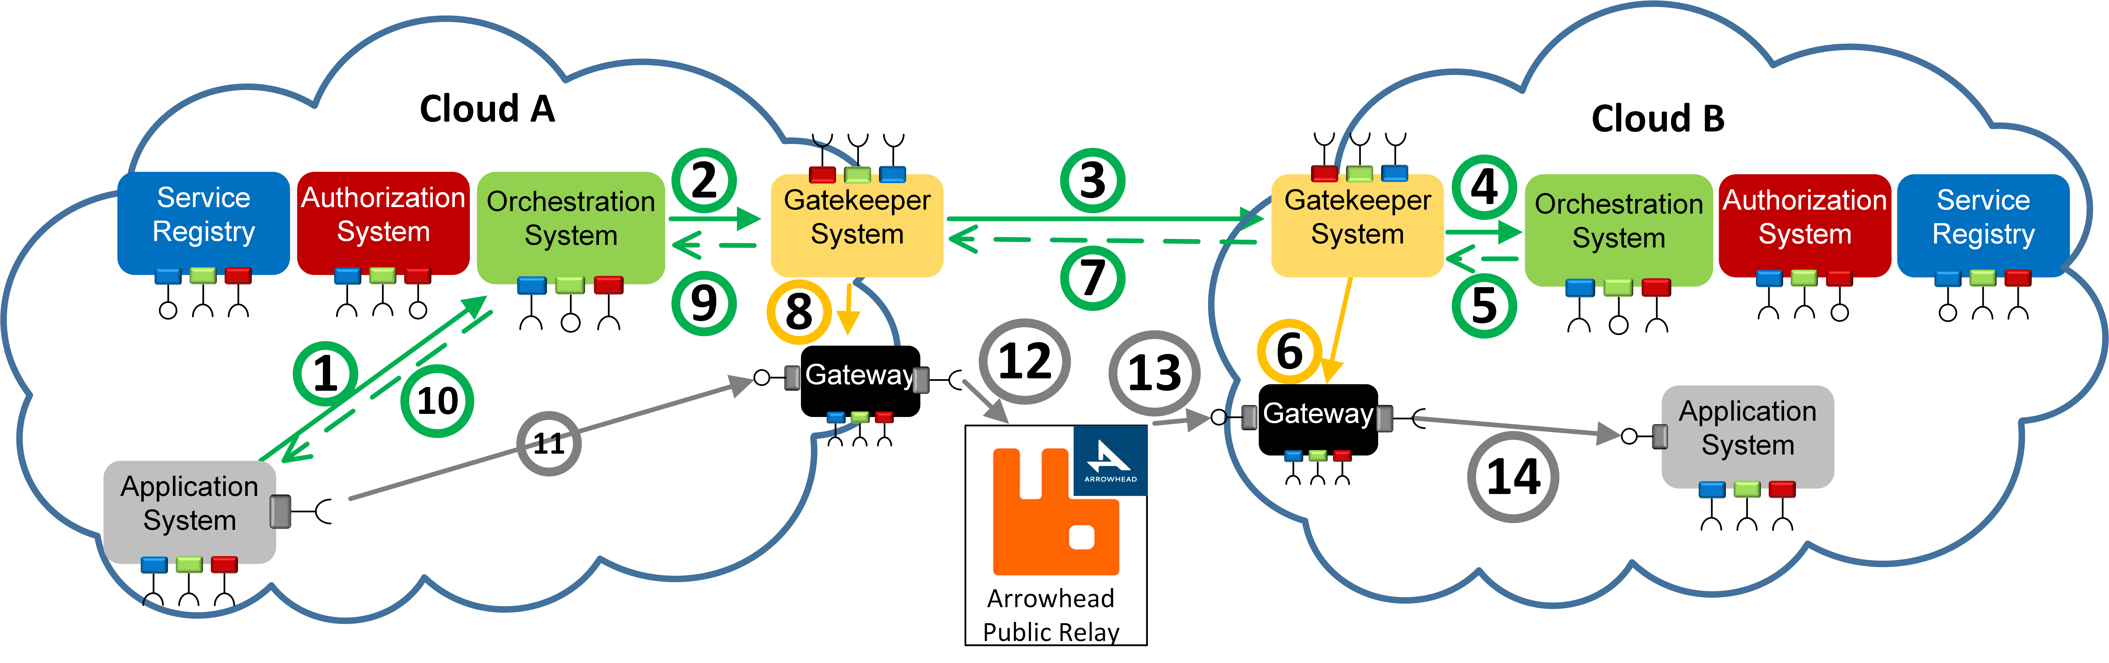

Slide 26
Interoperability guidelines Naming conventions

Slide 27
Need to update!
System naming
systemName must be unique within the LC, e.g. hostname
Service Naming
There will be governance to enable SD and IDD reuse between use case
Interface Naming
Guidelines need to be revised within the framework
HTTPS-TLS_TOKEN-PATH_JSON-SENML
Security levels as metadata
„none”<„tls”< „token”

Slide 28
Client skeletons and use

Slide 29
Provider skeleton pseudocode
main() {
init();
int res = register_to_SR(SREntry);
if (res!=200) remove_reregister();
start_HTTP(S)_server();?
// maybe add auth rules for consumers…
remove_from_registry(SREntry);
}
serve_request(HTTP payload) {
if (secure) verifyrequester(securitycontext, token);
return value;
}

Slide 30
Service Registration
HTTP POST: …:8442/serviceregistry/register
HTTP PUT: …:8442/serviceregistry/remove
{
"providedService": {
"serviceDefinition": "IndoorTemperature",
"interfaces": [ "json" ],
"serviceMetadata": {
"unit": "celsius"
}
},
"provider": {
"systemName": "InsecureTemperatureSensor",
"address": "127.0.0.1",
"port": 8454
},
"serviceURI": "temperature"
}

Slide 31
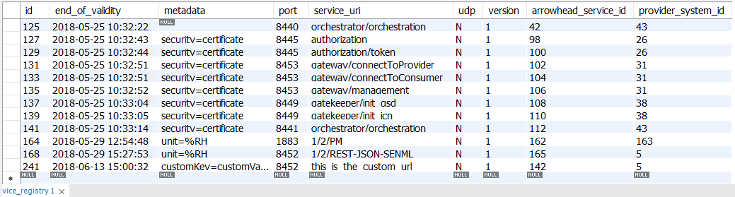
Contents of the ServiceRegistry afterwards (SQL)

Slide 32
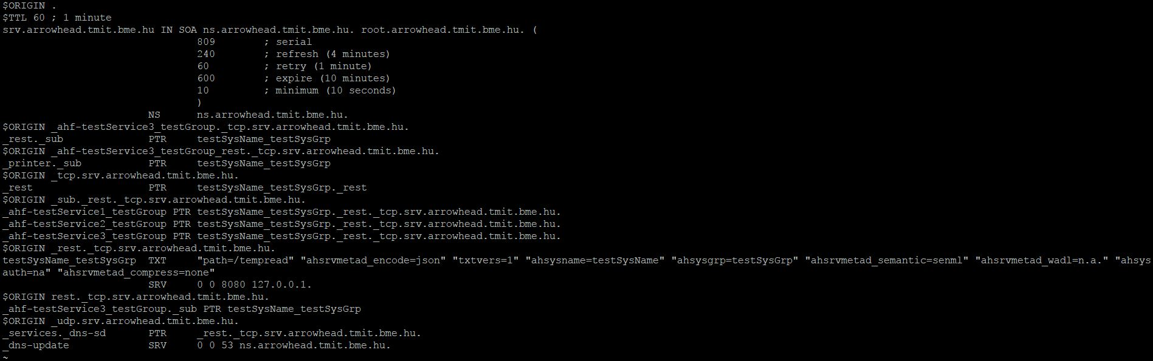
Contents of the SR (DNS)

Slide 33
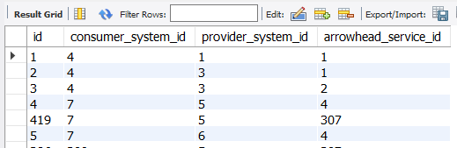
Authorization Rules
This is needed so that the consumer is allowed to use the service from the provider.

Slide 34
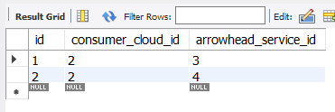
Or manually add inter-cloud auth rules in the database

Slide 35
The Orchestrator/Consumer will know…
Service instances that implement various security measures shall have this information submitted to the SR as metadata.
„security” = „SSL”
„token” = „required”
Via the secure REST interface
Orchestration Process: If the Orchestrator fetches a Service Provider with a Service that contains these metadata descriptors is will automatically.
No orch. proc. Implemented: When the Consumer looks up the Provider, it can also detect these key-values.

Slide 36
Consumer skeleton: option 1 (self-orchestration)
main (){
string url = lookup_orchestrator();
check_orchestration_store(url);
select_provider();
string authorizationURL = lookup_authorization();
fetch_token(authorizationURL, authRequest);
//… if inter-cloud is required, a lot of code
connect_to_provider(providerURL, token);
}

Slide 37
Consumer pseudocode: option 2
When the advanced Orchestration service is consumed. Service Consumers are simplier.
Main() {
init(); //hw init
string url = lookup_orchestrator();
request_orchestration(url,ServiceRequestForm);
parse_request(OrchResponse);
connect_to_provider(url, token);
}

Slide 38
Orchestration Service vs Orchestration Store

Slide 39
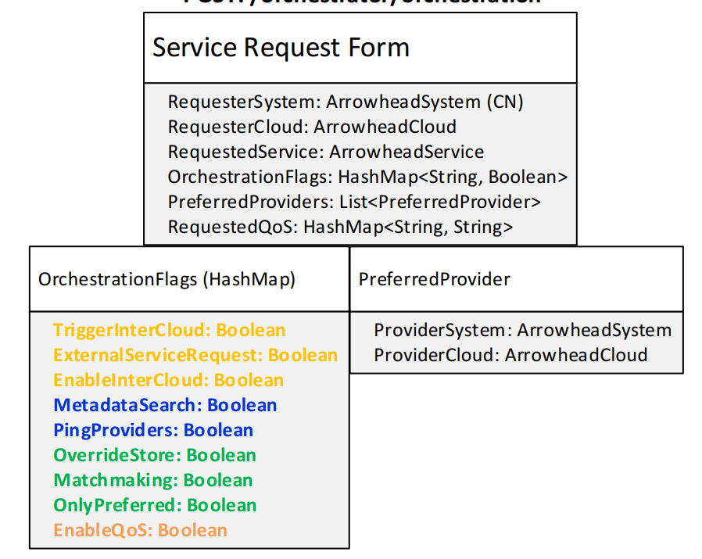
Orchestration Request
{
"requesterSystem":
{
"systemName": "ChargePointSystem",
"address": "dummy_address_4"
},
"requestedService":
{
"serviceDefinition": "ChargingProfile",
"interfaces": ["JSON"]
},
"orchestrationFlags": {
"overrideStore": true,
"enableInterCloud": true
}
}

Slide 40
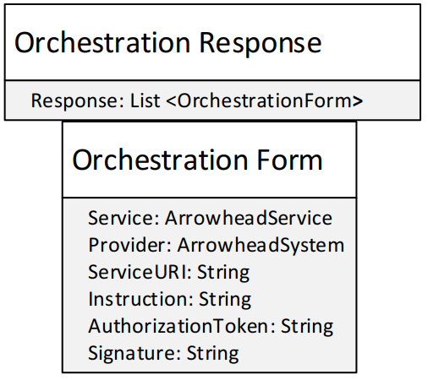
Orchestration Response
{
"response": [
{
"service": {
"serviceDefinition": "ChargingProfile",
"interfaces": [
"JSON"
],
"serviceMetadata": {
"maxDuration": "3600"
}
},
"provider": {
"systemName": "gateway",
"address": "10.0.0.82",
"port": 8001
},
"serviceURI": "charging_profile",
"instruction": "This provider is from another cloud!"
}
]
}

Slide 42
Coming in the next couple of month
Core System UI: management tool
Docker images released
Revision of Gatekeeper
Gateway integration with cloud platforms

